Slide 1


Derivatives
Calculus & Analytical Geometry MATH- 101
Instructor: Dr. Naila Amir (SEECS, NUST)

Slide 2
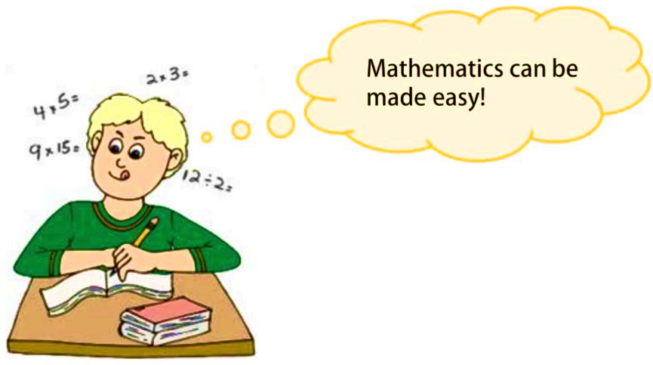
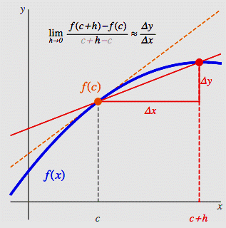
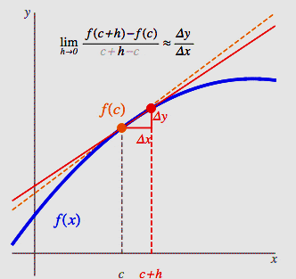
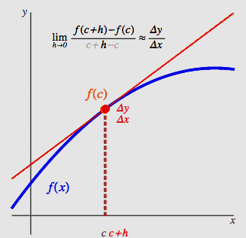
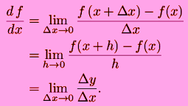
Derivative

Slide 3

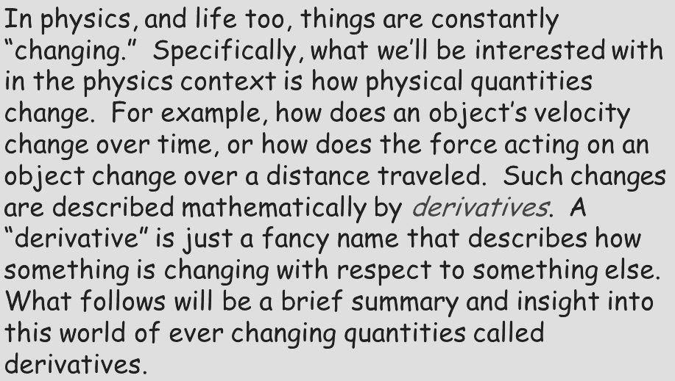
Why Do we need Derivatives???

Slide 4
Topics to be covered
Definition of derivative.
Geometric interpretation of the derivative.
Alternate form of the derivative.
Differentiable on an interval; one-sided derivatives.
When does a function not have a derivative at a point?
Differentiability by function type.
Differentiation rules.
Derivatives of some common functions.
Second and higher order derivatives.
Glossary.

Slide 5
Book: Thomas Calculus (11th Edition) by George B. Thomas, Maurice D. Weir, Joel R. Hass, Frank R. Giordano
Chapter: 3
Sections: 3.1,3.2, 3.4

Slide 6
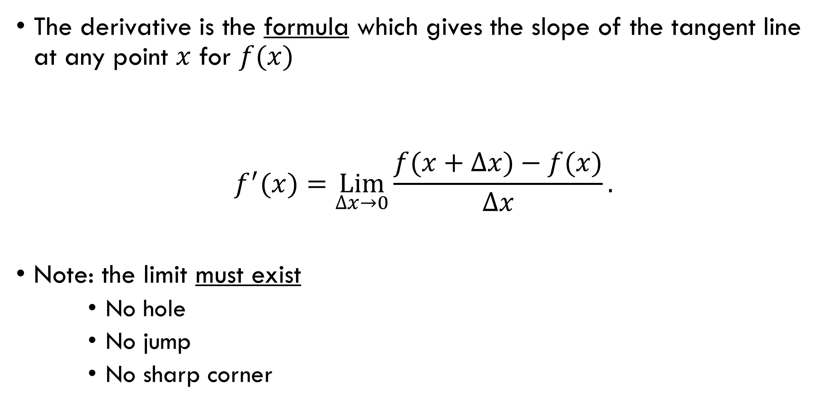
Definition of Derivative
The derivative is the formula which gives the slope of the tangent line at any point $x$ for $f(x)$
$$f^{′}(x)=\underset{∆x→0}{Lim}{\frac{f(x+∆x)−f(x)}{∆x}}.$$
Note: the limit must exist
No hole
No jump
No sharp corner

Slide 7
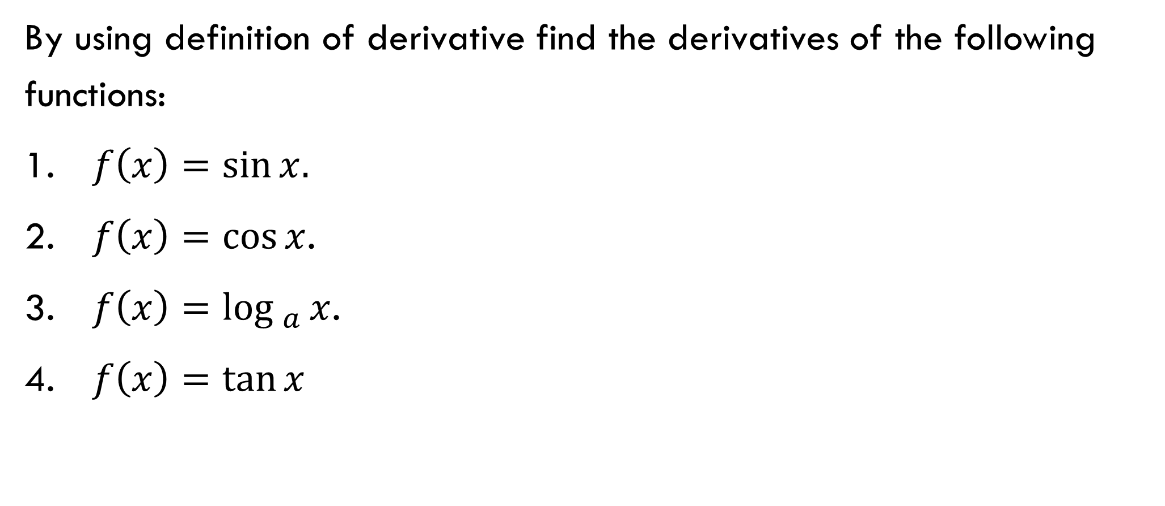
Examples:
By using definition of derivative find the derivatives of the following functions:
$f\left(x\right)=\sin{x.}$
$f\left(x\right)=\cos{x}$.
$f\left(x\right)=\log_{a}{x}$.
$f\left(x\right)=\tan{x}$

Slide 8
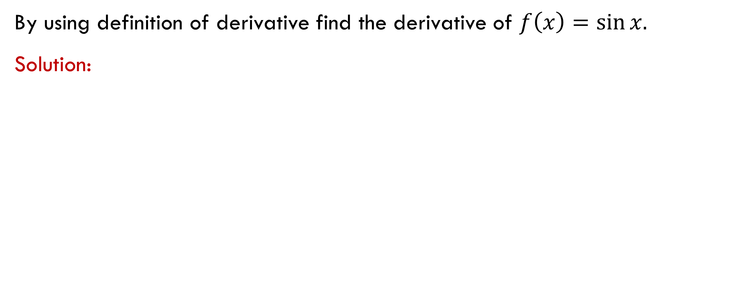
Examples:
By using definition of derivative find the derivative of $f\left(x\right)=\sin{x.}$
Solution:

Slide 10

Examples:
By using definition of derivative find the derivative of $f\left(x\right)=\log_{a}{x}.$
Solution:

Slide 13
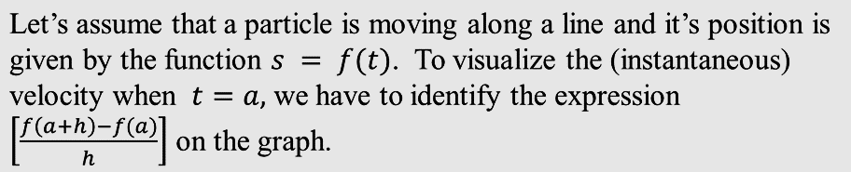
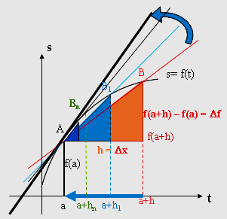
Geometric interpretation of the Derivative

Slide 14
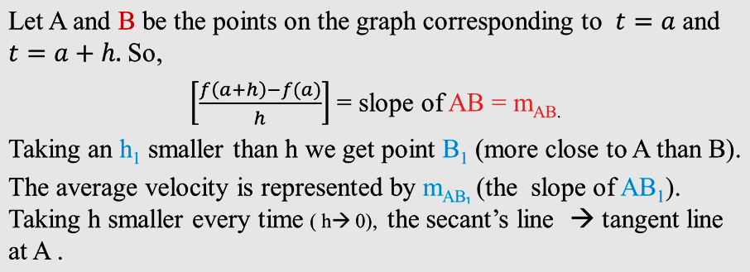
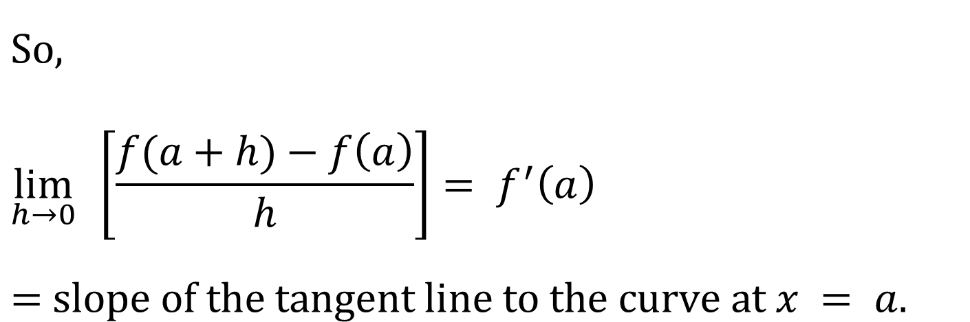
$$\text{So}\text{, } \\ \lim_{h→0}{ }\left[\frac{f(a+h)−f\left(a\right)}{h}\right]= f^{′}\left(a\right)$$
$=$ $\text{slope} \text{of} \text{the} \text{tangent} \text{line} \text{to} \text{the} \text{curve} \text{at} x = a.$

Slide 15
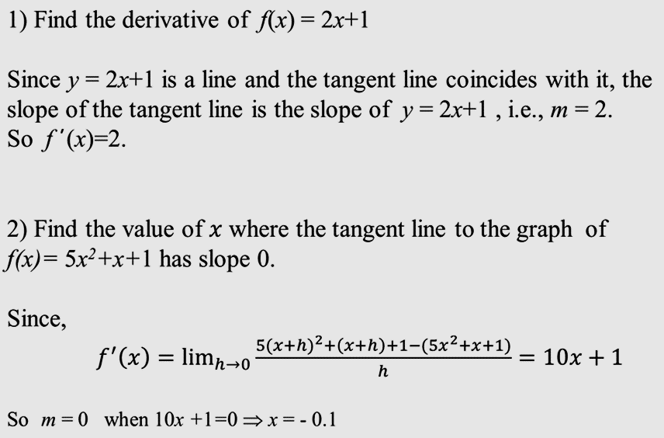
Examples

Slide 16

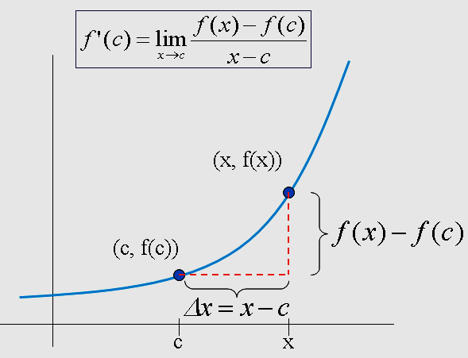
Alternate Form of the Derivative
(can only be used when finding the derivative at a specific point!!)

Slide 17
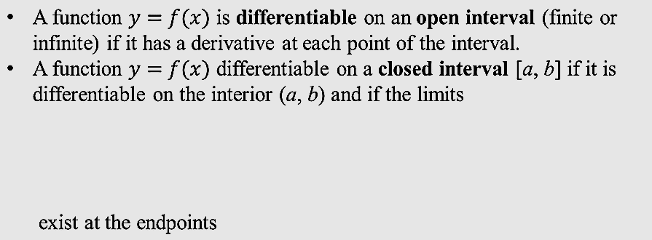
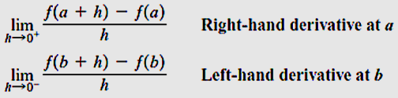
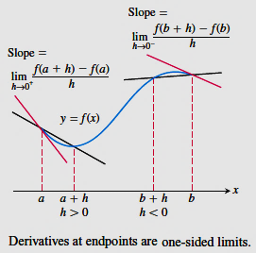
Differentiable on an Interval; One-Sided Derivatives

Slide 18
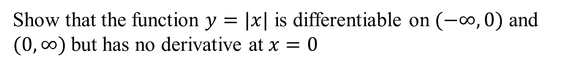
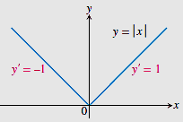
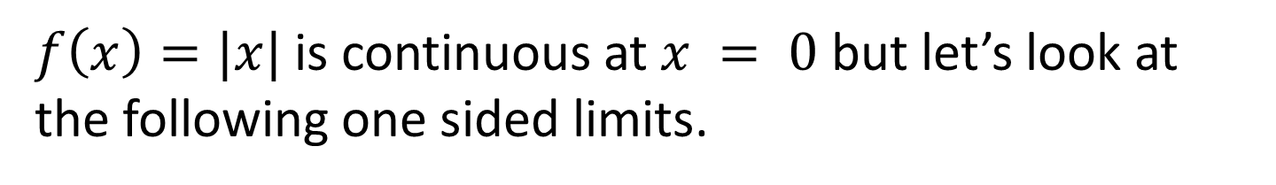
Example:
Solution:
$f\left(x\right)=|x|$ is continuous at $x = 0$but let’s look at the following one sided limits.
$$\lim_{h→0^{−}}{\frac{f(0+h)−f(0)}{h}}=\lim_{h→0^{−}}{\frac{\left|0+h\right|−|0|}{h}}=\lim_{h→0^{−}}{\frac{\left|h\right|}{h}}=\lim_{h→0^{−}}{\frac{−h}{h}}=−1.$$
$$\lim_{h→0^{+}}{\frac{f(0+h)−f(0)}{h}}=\lim_{h→0^{+}}{\frac{\left|0+h\right|−|0|}{h}}=\lim_{h→0^{+}}{\frac{\left|h\right|}{h}}=\lim_{h→0^{+}}{\frac{h}{h}}=1.$$

Slide 19
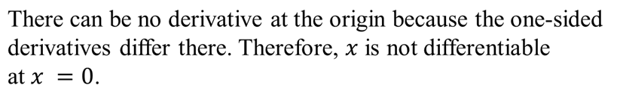
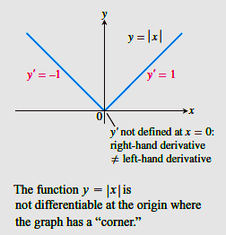

Slide 20
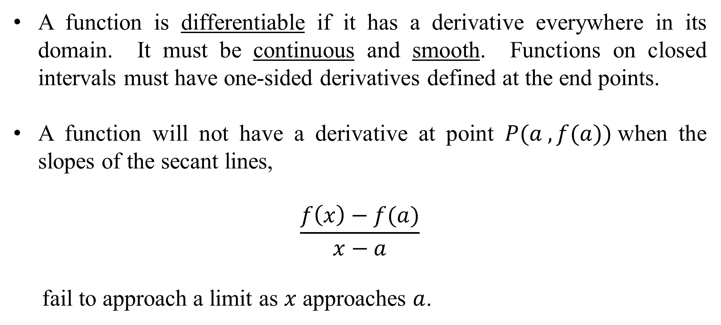
When Does a Function Not Have a Derivative at a Point?
A function is differentiable if it has a derivative everywhere in its domain. It must be continuous and smooth. Functions on closed intervals must have one-sided derivatives defined at the end points.
A function will not have a derivative at point $P(a , f(a))$when the slopes of the secant lines,
$$\frac{f\left(x\right)−f(a)}{x−a}$$
fail to approach a limit as $x$ approaches $a$.

Slide 21
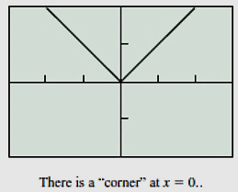
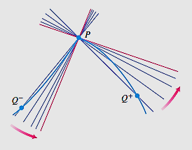
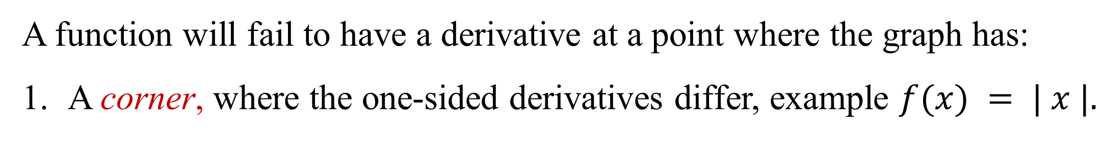
When Does a Function Not Have a Derivative at a Point?
A function will fail to have a derivative at a point where the graph has:
A corner, where the one-sided derivatives differ, example $f(x) = | x |.$

Slide 22
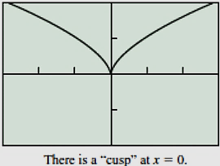
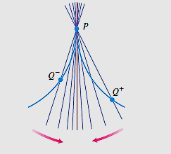
When Does a Function Not Have a Derivative at a Point?
A cusp, where the slopes of the secant lines approach infinity from one side and negative infinity from the other (an extreme case of a corner).

Slide 23
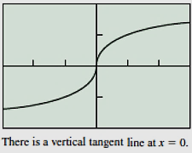
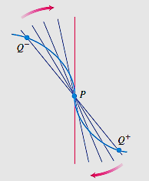
When Does a Function Not Have a Derivative at a Point?
A vertical tangent, where the slopes of the secant lines approach either infinity or negative infinity from both sides.

Slide 24
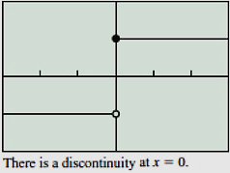
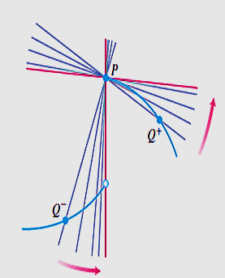
When Does a Function Not Have a Derivative at a Point?
A discontinuity (which will cause one or both of the one-sided derivatives to be non-existent). Example, the Unit Step Function.

Slide 25
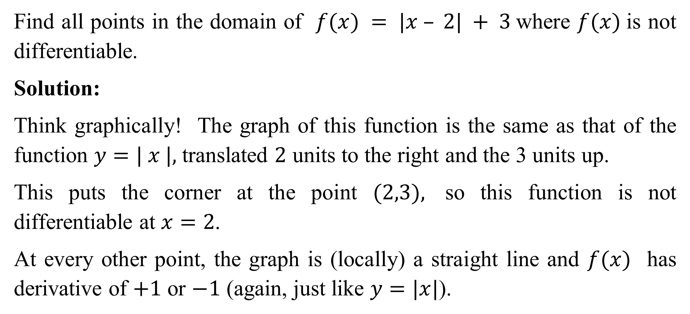
Example: Finding where a function is not differentiable
Find all points in the domain of $f(x) = |x – 2| + 3$where $f(x)$is not differentiable.
Solution:
Think graphically! The graph of this function is the same as that of the function $y=| x |,$translated $2$ units to the right and the 3 units up.
This puts the corner at the point $(2,3),$ so this function is not differentiable at $x=2$.
At every other point, the graph is (locally) a straight line and $f(x)$ has derivative of $+1$ or $−1$ (again, just like $y=|x|$).

Slide 26
Differentiability by function type
Most of the functions we encounter in calculus are differentiable wherever they are defined.
They will not have corners, cusps, vertical tangent lines, or points of discontinuity within their domains.
The graphs will be unbroken and smooth, with a well-defined slope at each point.
Polynomials are differentiable, as are rational functions, trigonometric functions, exponential functions, and logarithmic functions.
Composites of differentiable functions are differentiable, and so are sums, products, integer powers, and quotients of differentiable functions, where defined.

Slide 27
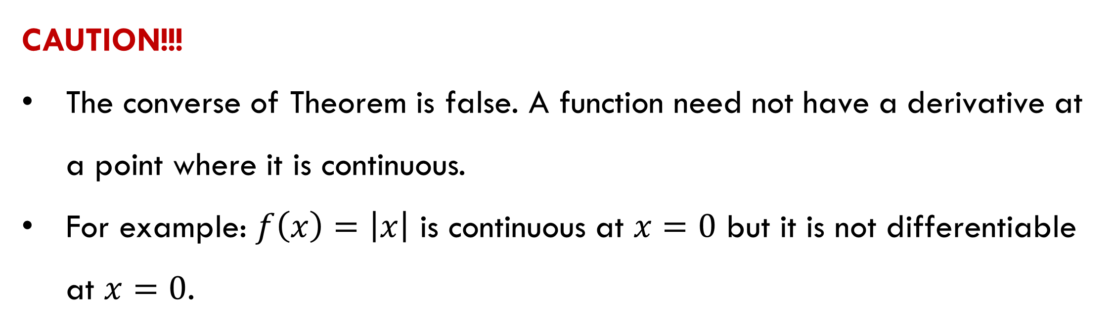
Theorem: Differentiability Implies Continuity
If $f\left(x\right)$has a derivative at $x = c,$then $f\left(x\right)$is continuous at $x = c$.
CAUTION!!!
The converse of Theorem is false. A function need not have a derivative at a point where it is continuous.
For example: $f\left(x\right)=\left|x\right|$ is continuous at $x=0$ but it is not differentiable at $x=0$.

Slide 28
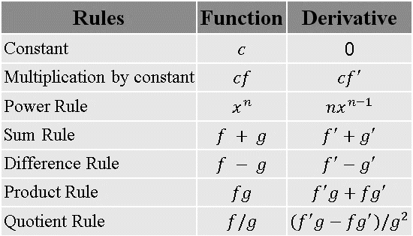
Differentiation Rules

Slide 29
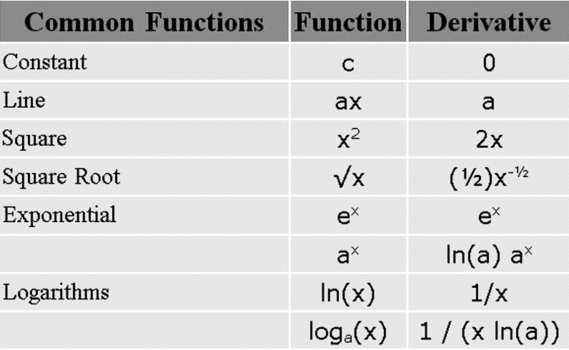

Derivatives of some common functions

Slide 30
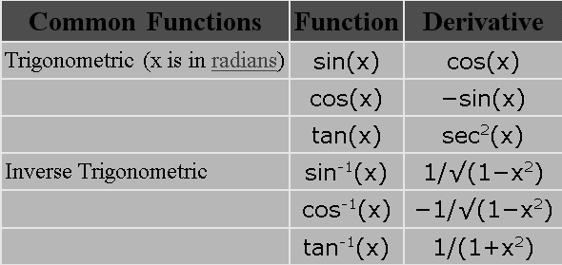
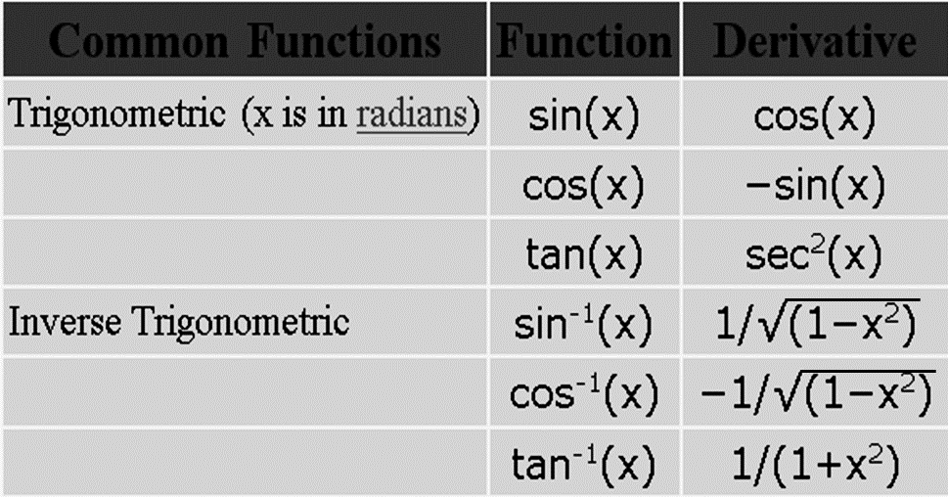
Derivatives of some common functions

